Slide 1
Review of HCAHPS Scores at CA Hospitals Data Analytics Bootcamp UC Berkeley Extension 04.05.2018
Janaki Kora
Jessica Phillips
Lena Tran
Naz Sinaei
Sema Uyar

Slide 2
Outline
Research questions
HCAHPS
Data sets
Data exploration and cleanup process
The analysis process
Conclusion
Questions

Slide 3
Research Questions
What are the counties in CA that do not have good HCAHPS Scores?
Do hospitals in high-income areas in CA get a higher overall HCAHPS score?
Does population have any effect on overall HCAHPS Score?
Is there any correlation between different HCAHPS rating categories?
Does the type of hospital ownership have any effect on HCAHPS Score?

Slide 4
HCAHPS
implements
US Health Department
Agency for Healthcare Research and Quality (AHRQ),
CAHPS Program >
CAHPS Survey
Centers for Medicare & Medicaid Services (CMS)
Other Federal Agencies…
requires

Slide 5
HCAHPS (Hospital Consumer Assessment of Healthcare Providers and Systems) Survey
standardized survey instrument and data collection methodology to measure patients' perspectives of hospital care.
integral part of CMS’ efforts to improve healthcare in the U.S.
some CAHPS surveys are used in Value-Based Purchasing (Pay for Performance) initiatives.
released publicly to give people a way to compare hospitals
Notes:
These initiatives represent a change in the way CMS pays for services. Instead of only paying for the number of services provided, CMS also pays for providing high quality services. The quality of services is measured clinically, administratively, and through the use of patient experience of care surveys.

Slide 6
Data Sets
2016 County Health Rankings California Data - v3.xls
http://www.countyhealthrankings.org/app/california/2016/downloads
HCAHPS-CA-Hospital.xlsx
Hospital General Information.csv
× Complications and Deaths - Hospital.csv
× Healthcare Associated Infections - Hospital.csv
× Timely and Effective Care - Hospital.csv
https://data.medicare.gov/data/hospital-compare
Notes:
Our hospital data came from data medicare.gov. We used the official data sets on medicare.gov. Hospital Compare website provided by CMS.

Slide 7
Data exploration and cleanup process
https://github.com/jLynnePhillips/Data_Bootcamp_Project1/tree/master/Analysis/Cleaned_Data

Slide 8
The analysis process
https://github.com/jLynnePhillips/Data_Bootcamp_Project1/blob/master/Analysis/Final_Analysis/Fine%20Tune%20Data%20Set.ipynb

Slide 9
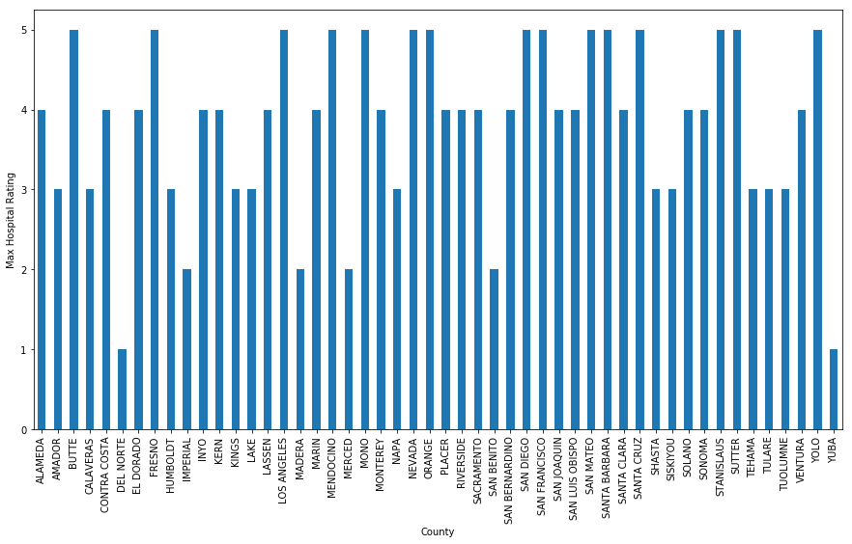
What are the counties that do not have good HCAHPS Scores? Del Norte and Yuba
Max Overall HCAHPS Scores per County

Slide 10
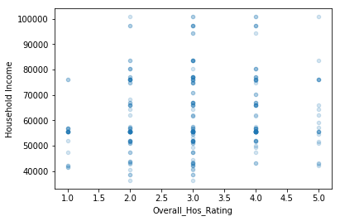
Do hospitals in high-income areas in CA get a higher HCAHPS score? Not according to our data sets
Overall HCAHPS score vs Income

Slide 11
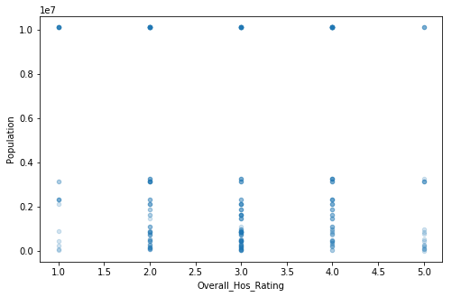
Does population have any effect on Hospital Ratings? Not according to our data sets
Overall HCAHPS Score vs. Population

Slide 12
HCAHPS Categories
Cleanliness
Nurse communication
Doctor communication
Staff responsiveness
Pain management
Communication with respect to medication
Discharge information
Care transition
Overall Hospital Rating
Notes:
Our hospital data came from data medicare.gov. We used the official data sets on medicare.gov. Hospital Compare website provided by CMS.

Slide 13
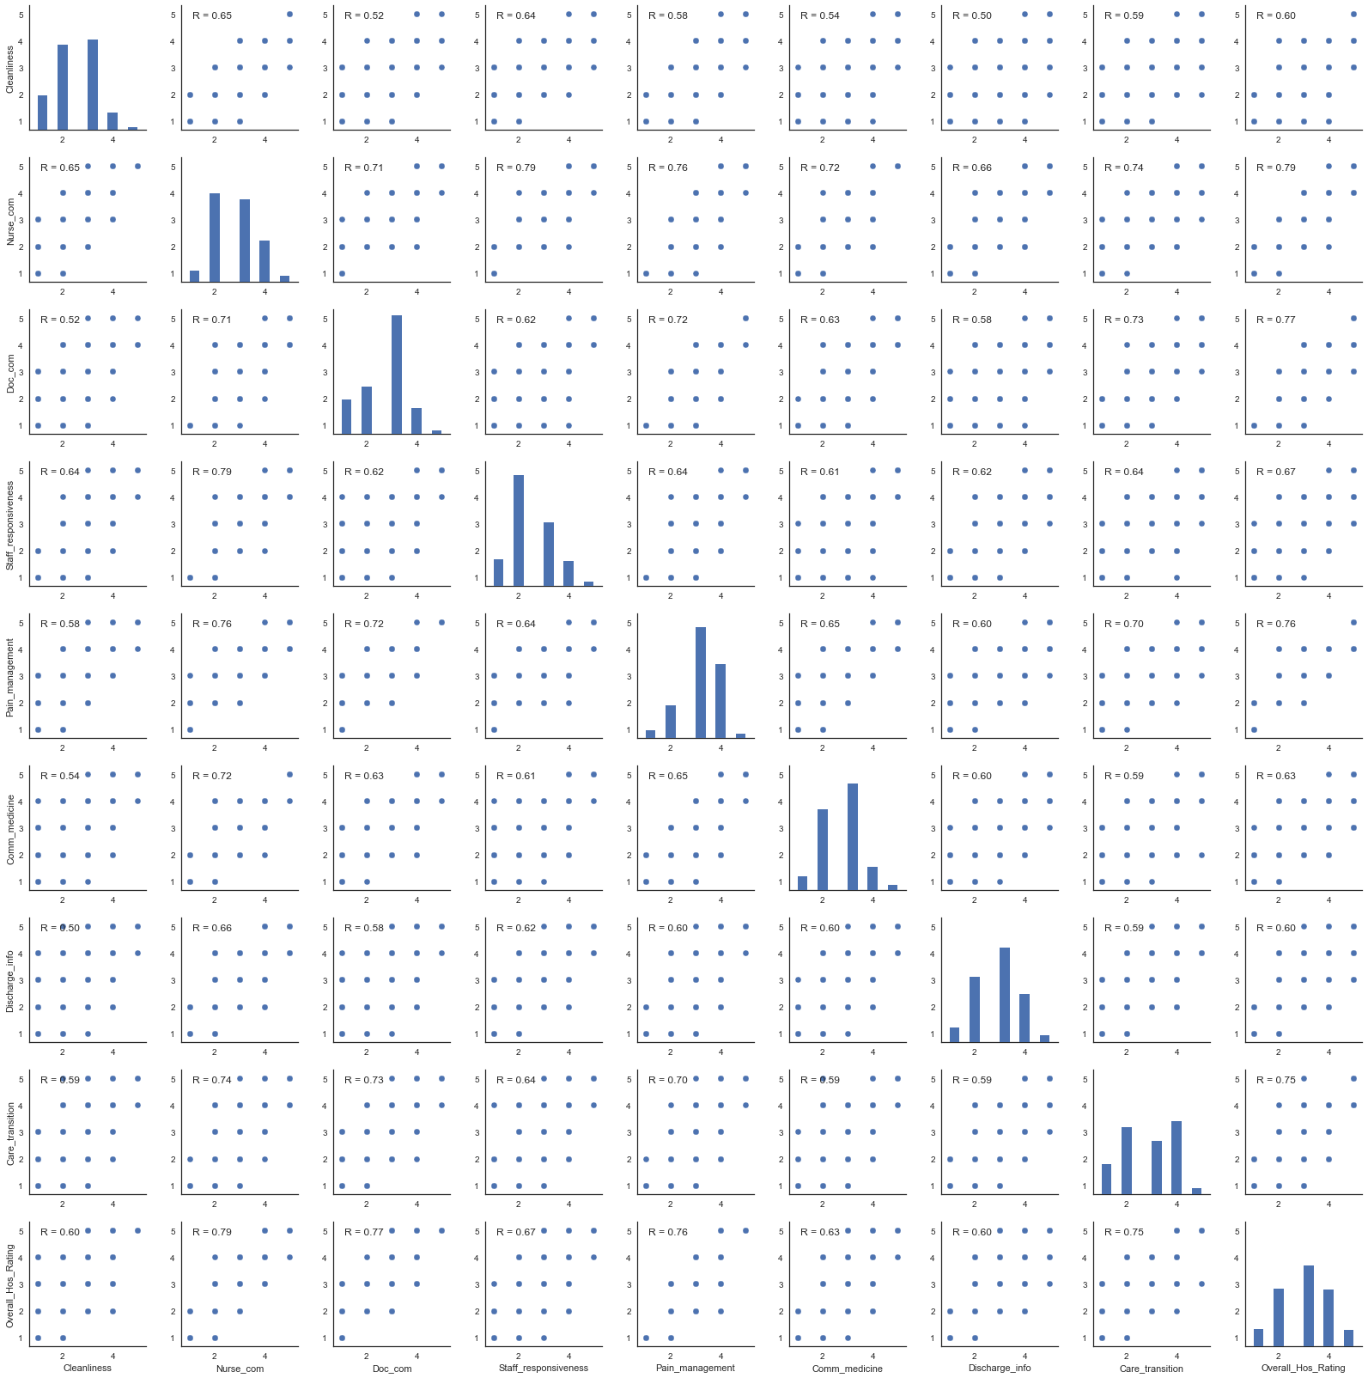
Is there any correlation between different HCAHPS rating categories? Nurse Communication, Doctor Communication, Pain Management and Care Transition have the highest positive correlation with the overall rating.
Correlation between different HCAHPS rating categories
Notes:
This implies that these four factors impact the overall rating the most and this impact is in a positive fashion, meaning that, for example, a higher pain management corresponds to a higher overall rating.

Slide 14
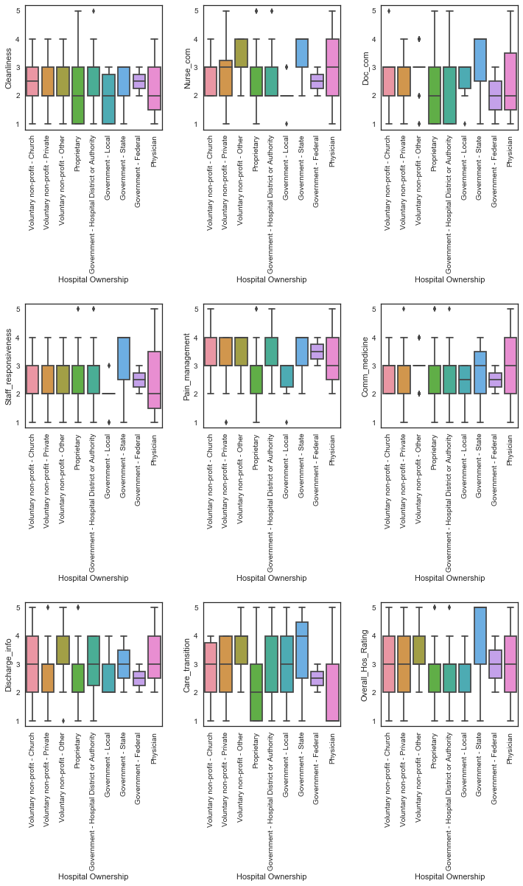
Does the type of hospital ownership have any effect on HCAHPS Score? Among the different hospital ownerships, government-federal hospitals have the most consistent scores with respect to all the ratings from multiple surveys.
Correlation between hospital type and different HCAHPS rating categories
Notes:
More precisely, the scores of government-federal hospitals are rather compactly distributed around the average which means that a consistent service is offered within the government-federal hospitals.

Slide 15
Questions?

Slide 16
Thank You!

